Slide 1


ELITE MINDS
Fill in the XXXXs

Slide 2
IDEA EVALUATION TEMPLATE
Things to Consider
Does it fit with SME’s needs? Is there demand?
Does it really meet the goals set initially?
Does it meet the requirements in our problem statement/Point Of View?
Does it answer our “How Might We” questions in a satisfying way?
Is it different enough from what exists to add additional value?
Do we have access to the budget—enough to implement even partially?
Is the technology available?
Will we be able to roll it out with the available resources?
Idea | SME(s) Name | Project Name | Project Description
Idea 1 | Manjo-Tuli Block farmer | Production analysis | To facilitate the cost of a product from inception until it reaches the market
Idea 2 | XXXX | XXXXX | XXXXX
Idea 3 | XXXXX | XXXXX | XXXXX
Idea 3 | XXXXX | XXXXX | XXXXX
Idea 4 | XXXXX | XXXXX | XXXXX
Selected
Final Project Recommendation Motivation
PRODUCTION ANANLYSIS

Slide 3
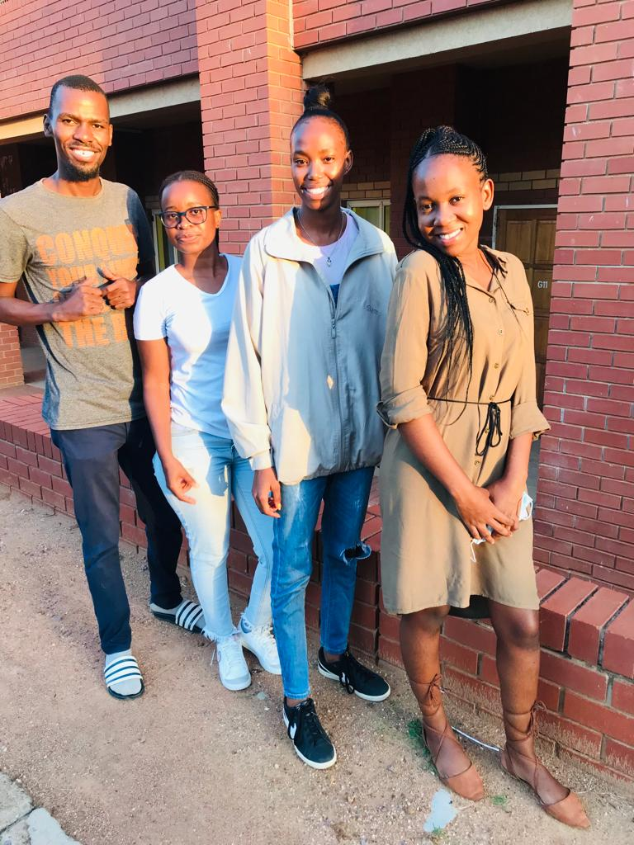
Selected Project Overview
Project Name:
XXXX
SME(s) Name:
How Might We Statements:
Project Team Name:
Manjo-Tuli Block farmer
How might we help with capacity planning
How might we keep statistics of productivity.
How might we facilitate the cost of a product from inception until it reaches the market
ELITE MINDS
SME(s) Full Description:
To facilitate the cost of a product from inception until it reaches the market.
Current Environment and business challenge identified :
Productivity management
Keeping statistics
Production process
Destruction of biodiversity
Project Stakeholders:
Expected Benefits:
Manjo-Tuli Block farmer
Molelekeng-Panda farmer
Gantsi farmer(Augustin Tema)
Thamaga farmer(Mr Bioikaego Pole)
Project Team:
Improved productivity management
Improved production process
Tangee Kaosonjo
Boago Okgetheng
Ontitretse Ishmael
Katlego Matlhodi

Slide 4
SME(s) Observation
Click Here
Observation Example
Name of interviewee(s):
Manjo-Tuli Block farmer
What | How | Why
The person looked anxious and worried. | Because they were asking more questions how this things will work. | Because the stakeholders seemed not sure about the technology that is going to be used To improve their production and analysis.

Slide 5

Empathy Map
Empathy Map Example
Click Here
Name of interviewee(s):
Manjo-Tuli Block farmer
USABILITY / TACTICAL NEEDS
( Practical needs & pain points )
What The User Said
Thoughts and Beliefs Identified
EMOTIONAL ASPIRATIONAL NEEDS
( Deeper needs & values. These may be based on your intuition or informed guesses )
They don’t need a mobile app , they need a productivity measurement
3% of staff are literate
They use chemical products, they know what diseases they get through seasons e.g problems during rainy seasons, mostly no problems during the winter season
No weather station
Keeping statistics of this process could help, capacity planning
Actions and Behaviors
They use chemical products
Plants vegetables and fruits
Feeling and Emotions
Worried about the changes and whether they’ll be consulted
Eager to make the most of this opportunity for change

Slide 6
PROBLEM DISOVERY CANVAS
Click Here
Problem Discovery Example
BUSINESS SITUATION
PERS
BUSINESS GOALS
OVERALL CAPABILITIES AND CONSTRAINTS
CONSTRAINTS
CAABILITIES
OPPORTUNITIES
Poor access to high-value markets Weather, climate volatility, and climate change Pests, diseases, and weeds Lack of research addressing regional, national, and local issues of the horticulture sector Postharvest losses and food safety k
To be able analyze and do statistical measurements. To give you how much statists of produce. Production yield. Cost analysis to do profits and loss analysis.
crops which create jobs and economic opportunities for rural communities, enables more profitable, intensive farming of small tracts of land in urban areas. Better information delivery (extension), reducing high crop losses and improving the value-chain from farm to fork are critical.
OUTCOMES Better yields Improved Profits.
METRICS More produce

Slide 7
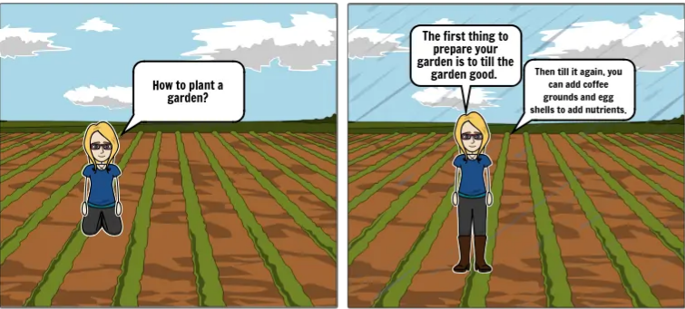
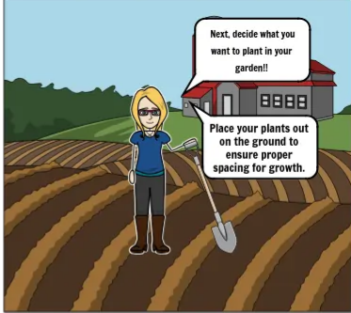
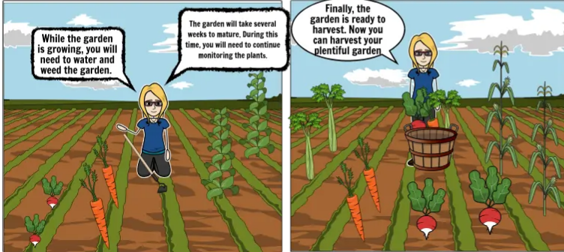
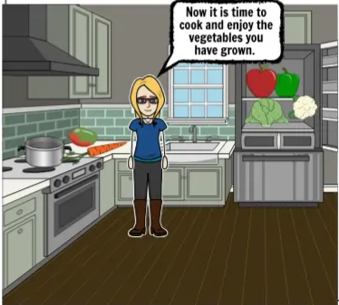
Story Board
Click Here
Storyboards Toolkit activity
Scenario:
Steps to grow a vegetable
DESCRIPTION 1:
Decision making
DESCRIPTION X:
Cultivation and planting
DESCRIPTION 3:
Watering and fertilisibng the planted soil
DESCRIPTION 4:
Harvesting and packaging
This the first step where one decide on the method of planting
Cultivating and planting of the soil
Wateing ang fertilizing of planted vegetables
Last step which is harvesting and packaging

Slide 8
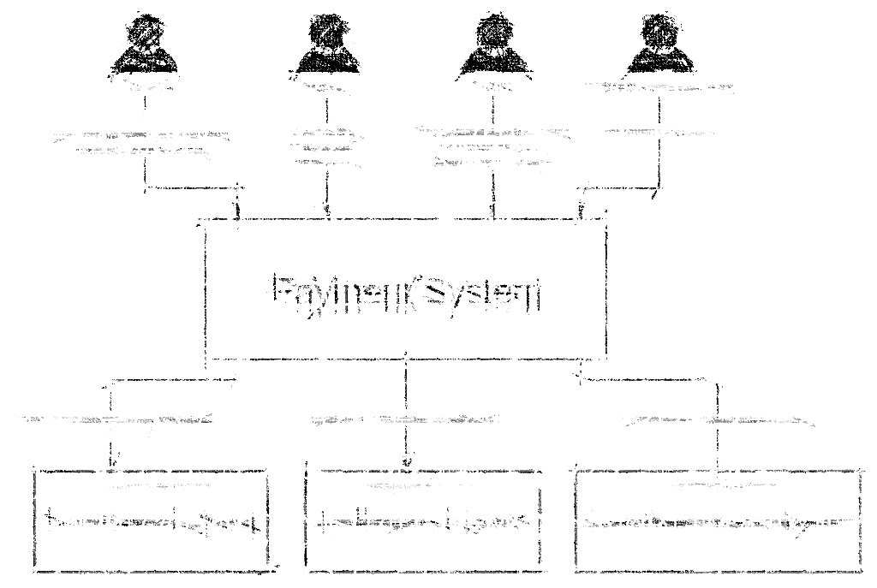
High Level System Architecture
Platforms/Tools
Django
Microsoft Excel
Sql Database
Visio

Slide 9

Project Summary Narrative
A report of everything from the day a farmer cultivates the land to the day the farmer sells the product .i.e The cost of: tools used to cultivate the land, fertilisers used, and amount used to test the type of soil used, seedlings and seeds used in the field, water used , harvesting and packing of the final product.

Slide 10


Slide 11
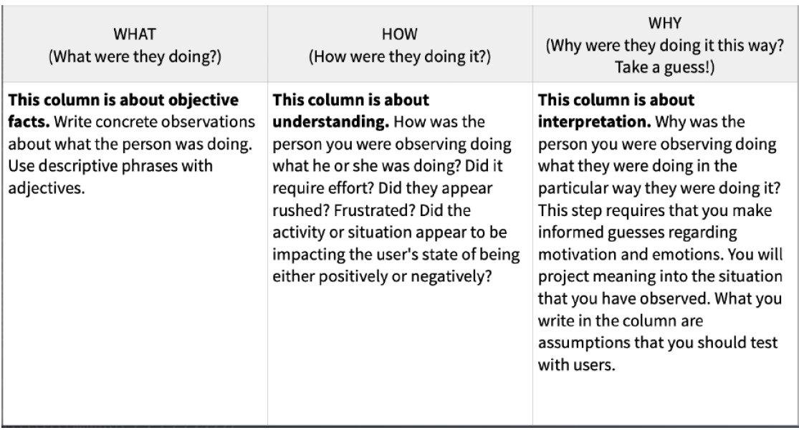
Observation Template

Slide 12
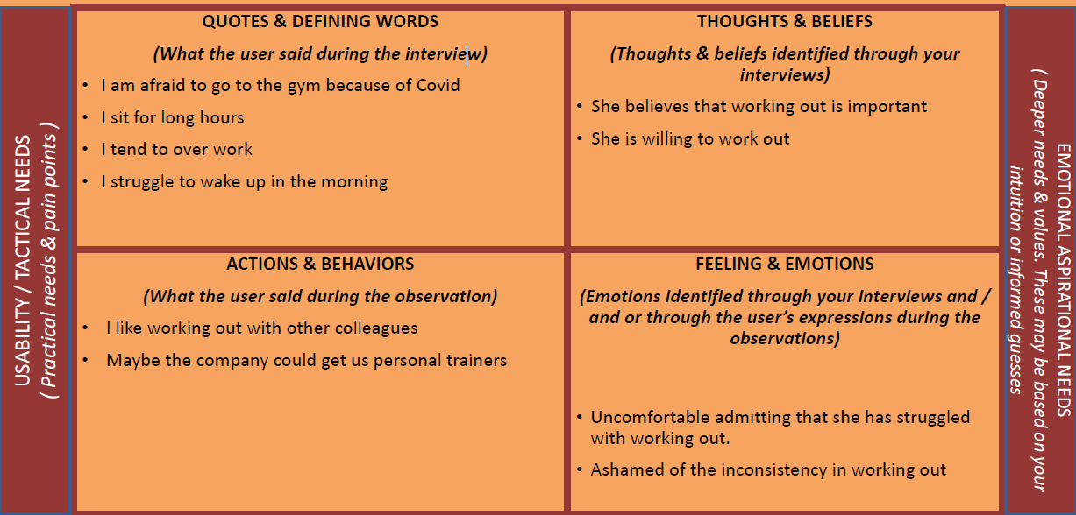
Empathy Map

Slide 13
PROBLEM DISOVERY CANVAS
CUSTOMER SITUATION
CUSTOMER JTBD
PERSONA
Gender – Female
Name – Lonyalo / Ame
Age: 34
PERS
CUSTOMER GOALS & MOTIVATIONS
Healthy lifestyle
Losing weight – 10 Kgs
Working 8 hours maximum
TASKS
PAINS & GAINS
Better work / life and living healthy balance Conducive working environment Lose weight Nice body Be beautiful
Time to exercise enough Can’t go to the gym because of covid Social distancing protocols Struggles to wake up in the morning Eating frequently Eating healthy Saving on time and fuel and time
BUSINESS SITUATION
PERS
BUSINESS GOALS
OVERALL CAPABILITIES AND CONSTRAINTS
Allocated budget to support employees.
Limited Budget
CONSTRAINTS
CAABILITIES
OPPORTUNITIES
Gym space The gym subscription can’t be utilized by colleagues Fewer colleagues, increased work load.
Wellness workshops Give vouchers instead of subscription
Pursue the idea of personal trainers Colleagues can top up the subscription to get personal trainers Partner with wellness centers to check in on colleagues Create for colleagues opportunities to purchase smart watches / fit bits to be reminded to exercise Virtual gym – trainer on MT or Zoom ; colleagues can utilize this Organize virtual marathons and cycling Allocate gym hour to colleagues
OUTCOMES Healthy workforce – reduced sick leaves and everyone shows up at work Reduced medical expenses
METRICS Losing weight – 10 Kgs Working 8 hours maximum

Slide 14
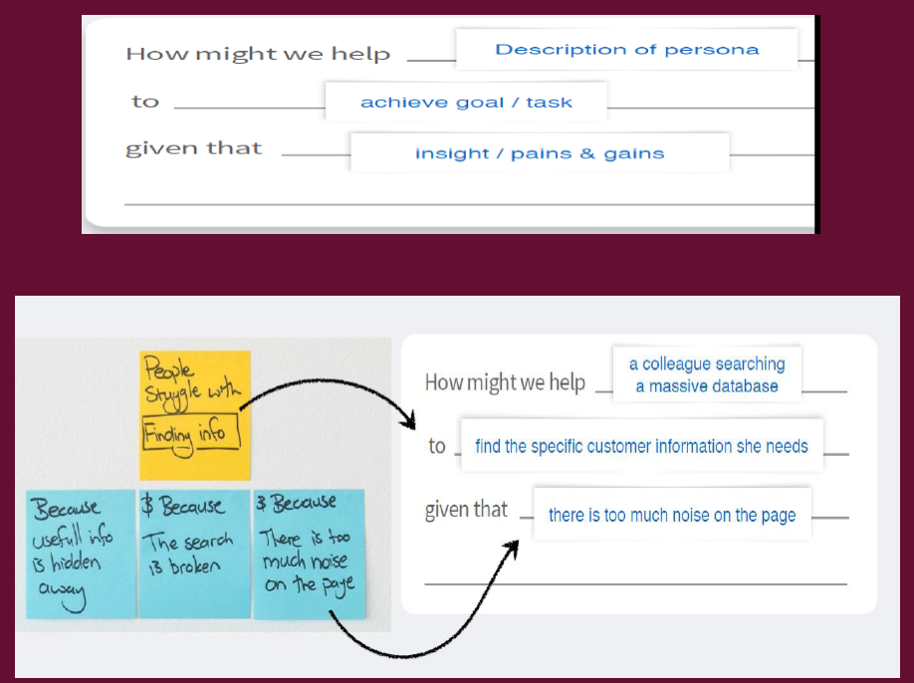
Problem Statement – How Might We….

